Slide 1
CoiNR
A non-fully featured cryptocurrency in Golang
CS 7610 Fall 2018
By Miles Benjamin and Peter Ivanov

Slide 2
Cryptocurrency and Blockchain
Cryptocurrency is based on Blockchain
Blockchain is a form of consensus protocol.
Based on a public ledger of data
Distributed P2P system
Uses “Proof-of-Work” to allow peers to vote / propose data
Data is fundamentally transaction based.

Slide 3
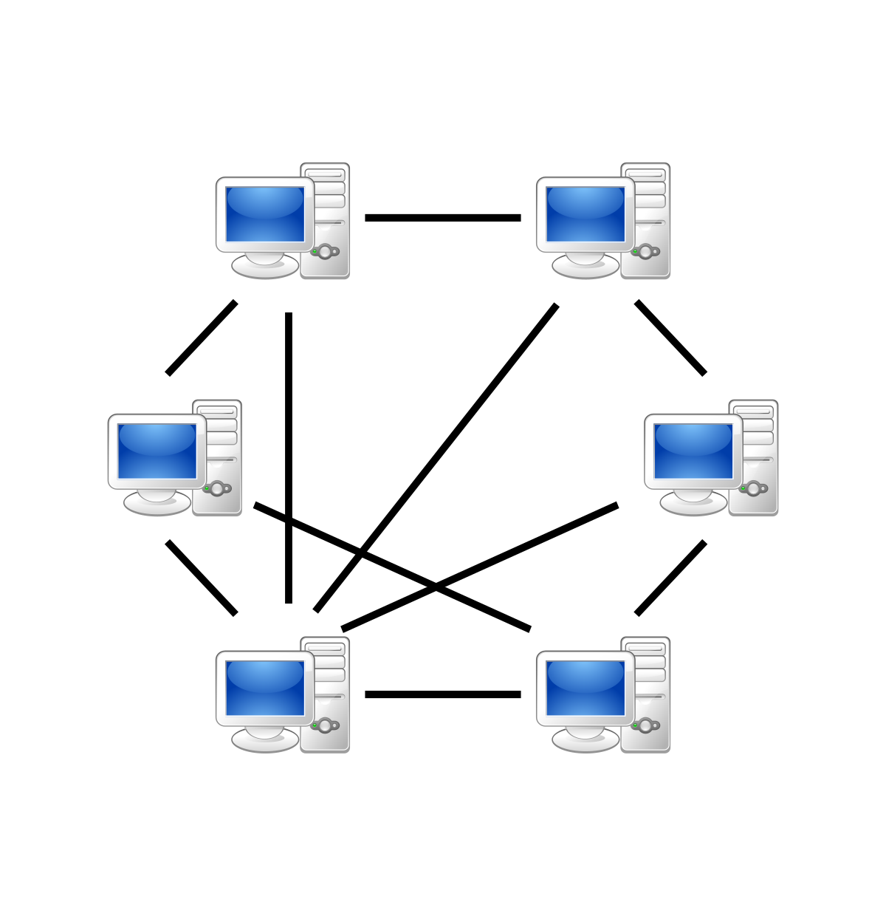
What’s the big deal?
P2P communication
No centralized authority
Hard to Generate, Easy to Validate Blocks
Hashable data
Difficulty agreement
Coin Ownership
Public/Private Keys
Easy to read Transactions

Slide 4

What was the plan?
Leverage libp2p-go for p2p communication
Focus on core features of blockchain
Block structure
Hashing
Proof-of-work
Stretch Goal: Transactions
Public/Private Keys
Transaction caching
Coinbase Transactions

Slide 5
What actually happened?
LibP2P was great but not perfect
Decided to focus on Blockchain rather than getting full networking working.
Successful Blockchain with Block Validation
Proof-of-work and Block Mining
Stretch Goal UNLOCKED
Transaction logging and Coin ownership
Transaction pool/verification
Transactions still entered manually

Slide 6
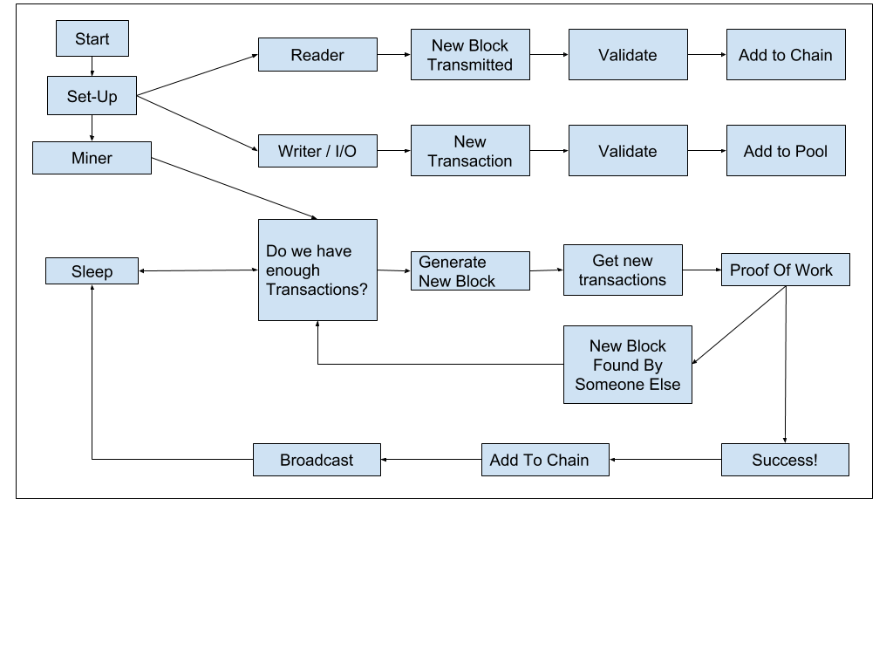
State Diagram

Slide 7
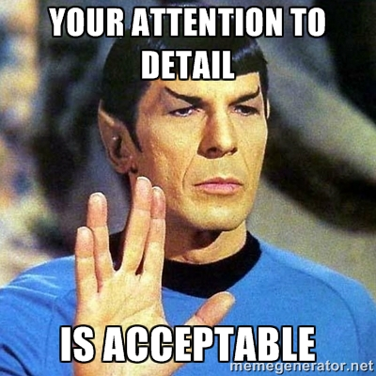
Some Interesting Details
Mining new blocks is surprisingly easy
Just require the hash to have a certain number of zeros in the beginning
Nonce term allows us to go through different hashes for same block
LibP2P deals with connection to different hosts differently
Available in multiple languages (GO, JS, Rust)

Slide 8

Challenges
Learning and using Libp2p-go
Open Source
Rapidly being developed
Poor Documentation
“Black Box”
Learning Golang
Biting off more than we can chew
Lots of deceptively tricky small features
Lots of external packages/APIs

Slide 9

Demo

Slide 10
Questions?

